Slide 1
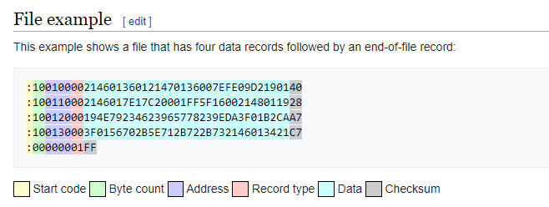
Check_sum = 0x01 + NOT (0x00+0x00+0x00+0x01) = 0x01+0xFE = 0xFF
Check_sum = 0x01 + NOT (10+01+30+00+3F+01+56+70+2B+5E+71+2B+72+2B+73+21+46+01+34+21)
= 0x01 + NOT (11+30+40+C6+89+9C+9D +94+47+55)
= 0x01+NOT(41+106+125+131+9C)
= 0x01+NOT(147+256+9C)
= 0x01+NOT(439)
= 0xC7

Slide 2
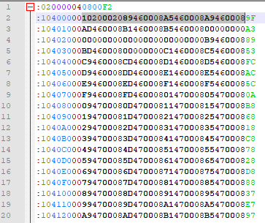
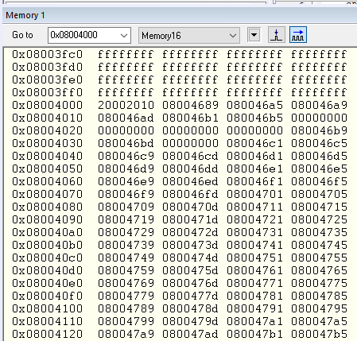
Little endian

Slide 3
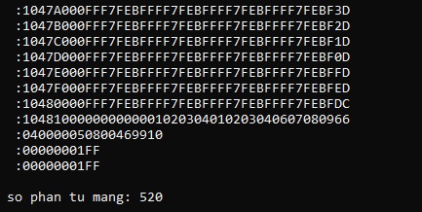
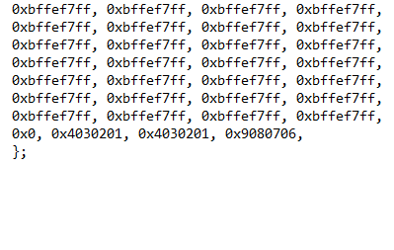

Slide 4
